Slide 1

React with Redux

Slide 2
BROWSER
SERVER
HTTP + URL
NAVIGATION
HTML PAGES
CSS
HTML + CSS
HTTP + URL
HTML + CSS
Page
Reload!

Slide 3
BROWSER
SERVER
HTTP + URL
NAVIGATION
HTML + CSS
Server PAGES
CSS
HTTP + URL
ASP
ASP .NET
JSP
PHP
Ruby
Express JS
HTML + CSS
Page
Reload!
DB

Slide 4
BROWSER
SERVER
HTTP + URL
NAVIGATION
Server PAGES
CSS
HTML + CSS + JS
AJAX - HTTP + URL
JS
Partial
Page
Reload!
PARTIAL HTML
ID
1
<table>
<thead>
<tr>
<th>ID</th>
</tr>
</thead>
<tbody>
<tr>
<td>1</td>
</tr>
</tbody>
</table>
ASP
ASP .NET
JSP
PHP
Ruby
Express JS
ASP .NET MVC
Spring MVC
Ruby On Rails
Laravel
Sails JS
DB

Slide 5
SERVER
Single Page Application (SPA)
SERVER PAGES
CSS
BROWSER
HTTP + URL
NAVIGATION
JS
HTML + CSS + JS
(Client Side JS App)
ASP
ASP .NET
JSP
PHP
Ruby
ASP .NET MVC
Spring MVC
Ruby On Rails
Laravel
<table>
<thead>
<tr>
<th>ID</th>
</tr>
</thead>
<tbody>
<tr>
<td>1</td>
</tr>
</tbody>
</table>
SERVER
AJAX - HTTP + URL
RESTful API
ASP .NET Web API
JWS
Express JS
Python
DB
JSON to HTML on Client Side
JSON
{
“id”:1
}
Vanilla JS, jQuery, KO, BB, NG 1,
NG 2 & Above, Vue JS, React JS

Slide 6
SERVER
Single Page Application (SPA)
SERVER PAGES
CSS
BROWSER
HTTP + URL
NAVIGATION
JS
HTML + CSS + JS
(Client Side JS App)
ASP
ASP .NET
JSP
PHP
Ruby
ASP .NET MVC
Spring MVC
Ruby On Rails
Laravel
<table>
<thead>
<tr>
<th>ID</th>
</tr>
</thead>
<tbody>
<tr>
<td>1</td>
</tr>
</tbody>
</table>
Account
Service
AJAX - HTTP + URL
API GATEWAY
Inventory
Service
JSON to HTML on Client Side
JSON
{
“id”:1
}
Vanilla JS, jQuery, KO, BB, NG 1,
NG 2 & Above, Vue JS, React JS
Shipping
Service

Slide 7
JavaScript Full Stack Application
 | Database | Application FW / API FW | Client Side | Hosting / Server
MEAN | MongoDB | Express JS | Angular | Node
MERN | MongoDB | Express JS | React JS | Node
MEVN | MongoDB | Express JS | Vue JS | Node

Slide 8
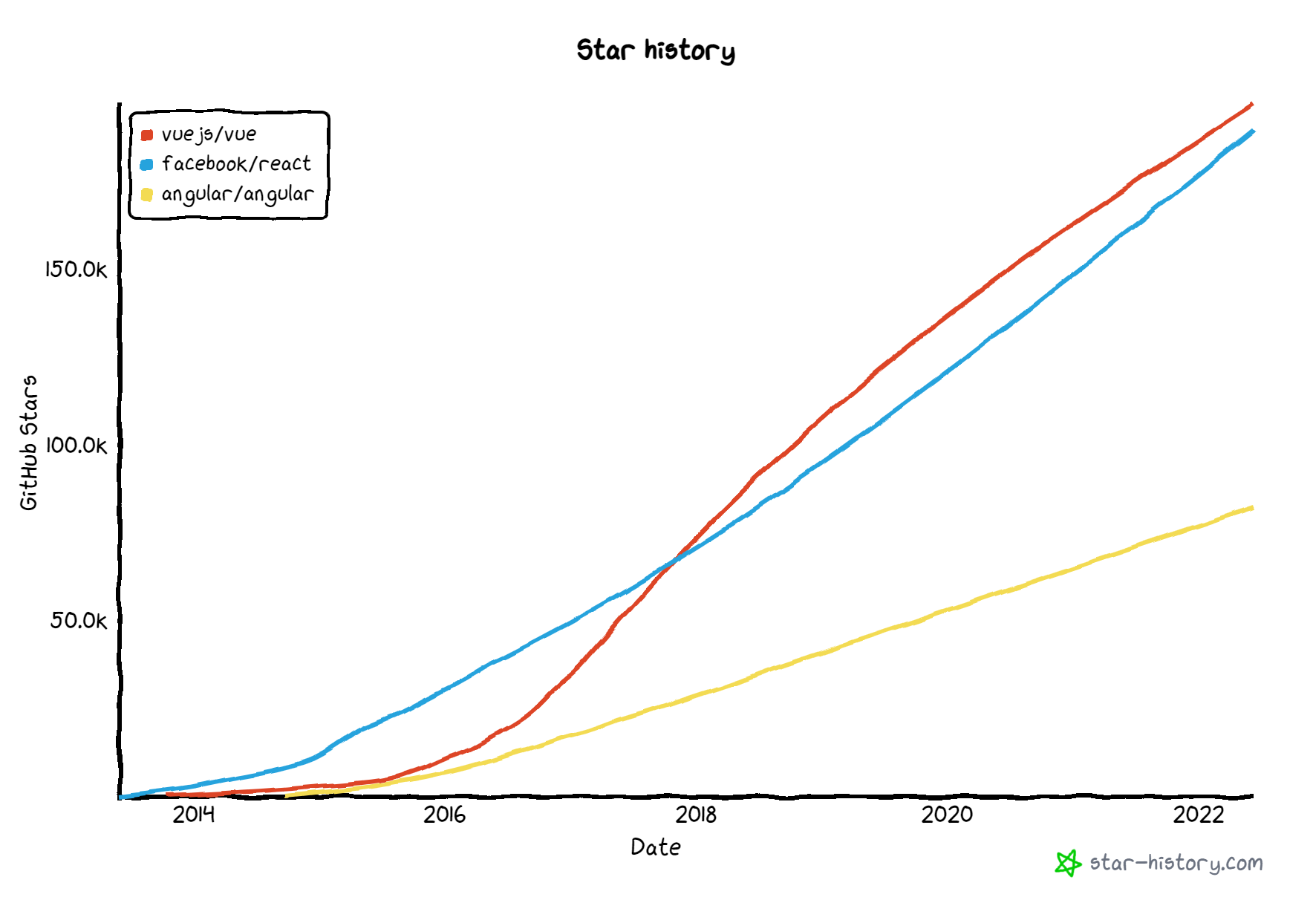

Slide 9
Library vs Framework
Library | Framework
Collection of API’s, targeted to do one specific task | Collection of API’s, targeted for application creation. FW is a piece of code that dictates the architecture of your project.
You are in Full control when you call a method from a library and the control is then returned. | The code never calls into a FW, instead the FW uses your code. We can only follow a FW.
It can be integrated seamlessly into an existing project. | FW cannot be integrated, we have to re-write the code.
jQuery – DOM Manipulation & Ajax Moment.js – Date & Time D3.js – Data Visualization React JS – UI Component | Angular

Slide 10
HTML and CSS
HTML and CSS
0
+
-
0
+
-
domHandler
domHandler
Counter
{
count: 0,
next: function() { this.count +=1; } ,
prev: function() { this.count -=1; }
}
Counter
{
count: 0,
next: function() { this.count +=10; } ,
prev: function() { this.count -=10; }
}
<Counter />
<Counter interval=“10”/>

Slide 11
Desktop Application
(Cross Platform)
ELECTRON JS
BROWSER (Client Side)
REACTDOM
REACT COMPONENT
View* (UI) – JS / JSX
Style (CSS) – JSX / CSS
Data (Inside) – State
Data (Outside) – Props
Behaviour – Methods
Mobile Application
REACTNATIVE
Node JS App (Server Side)
REACTDOMSERVER

Slide 12
UI Composition (Composite UI Pattern)
NAVIGATION
ADVER.
MENU ITEM
MENU ITEM
MENU ITEM
MENU ITEM
SIDE NAVIGATION
LIST AREA
DETAILS AREA
STATUS

Slide 13
Installation
Install Node Latest LTS version - https://nodejs.org/en/
Install / Update Visual Studio Code to Latest Release - https://code.visualstudio.com/
Extensions of Visual Studio Code
AutoFileName
vscode-icons
JavaScript (ES6) code snippets
CSS Formatter
IntelliSense for CSS class names in HTML
Reactjs code snippets
After Extensions are installed
File Menu -> Preferences -> File Icon Theme -> Select VScode Icons

Slide 14
Browser Extensions Installation
Install Google Chrome Extensions
React Developer Tools
https://chrome.google.com/webstore/detail/react-developer-tools/fmkadmapgofadopljbjfkapdkoienihi
Redux DevTools
https://chrome.google.com/webstore/detail/redux-devtools/lmhkpmbekcpmknklioeibfkpmmfibljd

Slide 15
Client Side Build
ES 2015 + (JSX)
(Multiple Files)
Auto Configuration
CLI (create-react-app)
react-scripts
Babel +
Preset (Env) +
Preset (React) +
Polyfill (core-js)
Build & Deploy your
Project on Local Server
npm start
Build your project
npm run build
Browser Compatible Files
(Multiple Files)
WEBPACK
CLI
WEBPACK-DEV-
SERVER
Bundling
BROWSER
WEBPACK
Single File / Set of Files
Local
HTTP Server
HTML PAGE
Deploy
Inject Bundles

Slide 16
Using React CLI
To Create a new application
npx create-react-app first-app
cd first-app
Commands available in the application
npm start
Starts the development server.
npm run build
Bundles the app into static files for production.
npm run test
Starts the test runner.
npm run eject
Removes this tool and copies build dependencies, configuration files and scripts into the app directory. If you do this, you can’t go back!

Slide 17
Using Bootstrap
Install
npm i bootstrap
npm i bootstrap-icons
Include bootstrap and bootstrap-icons css file in index.js

Slide 18
Assignment
Create and render the following components
Component One
Hello from Component One (text-success)
Component Two
Hello from Component Two (text-primary)

Slide 19
State
The state is an updatable structure that is used to contain data or information about the component and can change over time.
The change in state can happen as a response to user action or system event.
It is the heart of the react component which determines the behavior of the component and how it will render.
It represents the component's local state or information.
It can only be accessed or modified inside the component or by the component directly.

Slide 20
Props
Props are read-only structure.
It is an object which stores the value of attributes of a component and work similar to the HTML attributes.
It allows passing data from one component to other components.
Props are immutable so we cannot modify the props from inside the component.

Slide 21
Props vs State
Props | State
Props are read-only. | State changes can be asynchronous.
Props are immutable. | State is mutable.
Props allow you to pass data from one component to other components as an argument. | State holds information about the components.
Props can be accessed by the child component. | State cannot be accessed by child components.
Props are used to communicate between components. | States can be used for rendering dynamic changes within the component.
Props make components reusable. | State cannot make components reusable.
Props are external and controlled by whatever renders the component. | The State is internal and controlled by the React Component itself.

Slide 22
How Browser Renders a Web Page?
DOM
HTML Parser
DOM Tree
Layout
HTML
Attachment
Render Tree
Painting
Display
CSS
CSS Parser
Style Rules (CSSOM)

Slide 23
Solution – Virtual DOM
Virtual DOM is an in-memory representation of real DOM.
It is a lightweight JavaScript object which is a copy of Real DOM.
Whenever setState() method is called, ReactJS creates the whole Virtual DOM from scratch.
At any given time, ReactJS maintains two virtual DOM, one with the updated state Virtual DOM and other with the previous state Virtual DOM.
ReactJS using diff algorithm compares both the Virtual DOM to find the minimum number of steps to update the Real DOM.

Slide 24
Virtual DOM
Updating virtual DOM in ReactJS is faster because ReactJS uses
Efficient diff algorithm
Batched update operations
Efficient update of subtree only
Uses observable instead of dirty checking to detect the change

Slide 25
props
Call setState()
React Component
(state)
Render function of the
Component is called by
Event Fired
ReactDOM
Ready for User Interaction
DELTA’s will be rendered and Browser DOM will update
Virtual DOM
New Virtual DOM is compared with the Old Virtual DOM
DELTA’s

Slide 26
Methods & Properties in a React Component
Instance Methods
constructor()
render()
componentDidMount()
componentDidUpdate()
shouldComponentUpdate()
getSnapshotBeforeUpdate()
setState()
forceUpdate()
componentDidCatch()
componentWillUnmount()
Instance Properties
state
props
context
Class Properties (Static)
defaultProps
propTypes
displayName
contextType
Class Method (Static)
static getDerivedStateFromProps()
static getDerivedStateFromError()

Slide 27
Lifecycle Methods in a React Component
Mounting Phase
constructor()
static getDerivedStateFromProps()
render()
componentDidMount()
Updating Phase
static getDerivedStateFromProps()
shouldComponentUpdate()
render()
getSnapshotBeforeUpdate()
componentDidUpdate()
Unmounting Phase
componentWillUnmount()
Error Phase
static getDerivedStateFromError()
componentDidCatch()

Slide 28
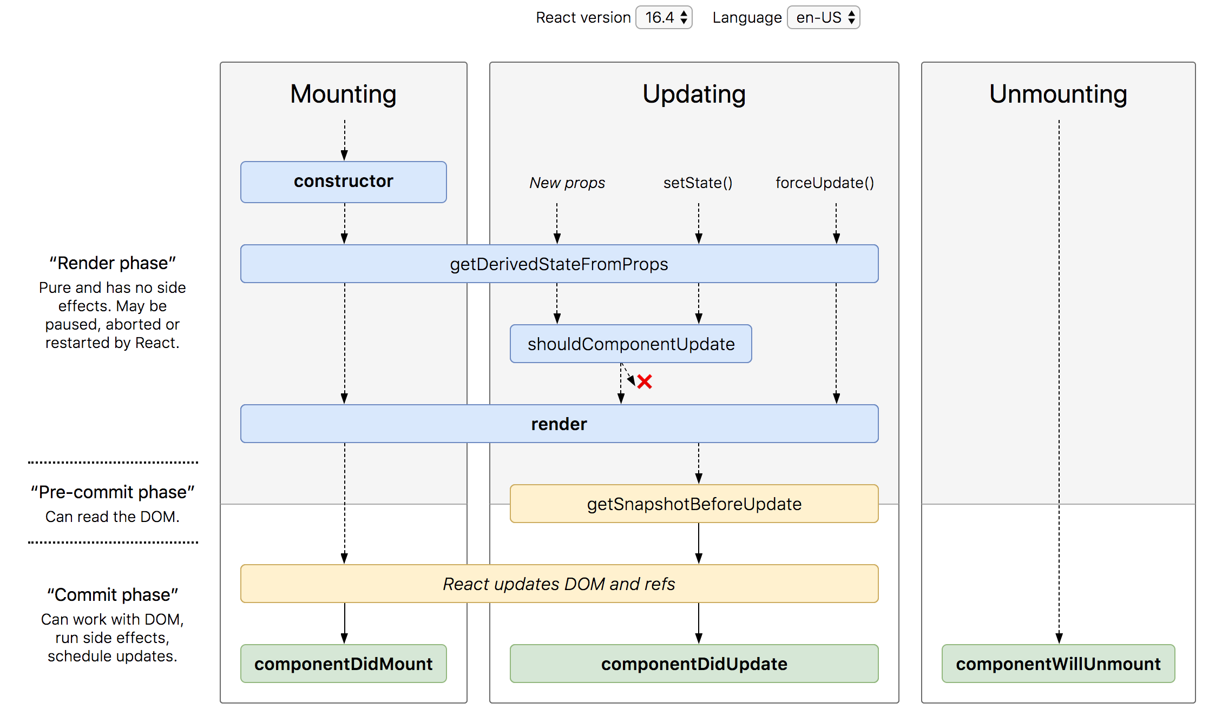
Lifecycle Methods

Slide 29
SyntheticEvent Object
Your event handlers will be passed instances of SyntheticEvent, a cross-browser wrapper around the browser’s native event.
It has the same interface as the browser’s native event, including stopPropagation() and preventDefault(), except the events work identically across all browsers.
The synthetic events are different from, and do not map directly to, the browser’s native events.

Slide 30
SyntheticEvent object attributes
boolean bubbles
boolean cancelable
DOMEventTarget currentTarget
boolean defaultPrevented
number eventPhase
boolean isTrusted
DOMEvent nativeEvent
void preventDefault()
boolean isDefaultPrevented()
void stopPropagation()
boolean isPropagationStopped()
void persist()
DOMEventTarget target
number timeStamp
string type

Slide 31
Rules to remember
The UI will update only when setState() is called to modify the state.
The state of the component, can be modified only by the method of the same component, using setState()
Never create the data in the state, if you are not using it on the UI.
The data flows unidirectionally, from state to the template of the component or from parent to child.

Slide 32
Parent Child Communication
PARENT
PARENT
Parent
Method
Reference
props
Ref (methods)
CHILD
CHILD

Slide 33
Sibling Communication
Parent Component
Parent
Method
Reference
props
CHILD Component
1
CHILD Component
2

Slide 34
Controlled Component
A controlled component is bound to a value, and its changes will be handled in code by using event-based callbacks.
The input form element is handled by the react itself rather than the DOM.
The mutable state is kept in the state property and will be updated only with setState() method.
Controlled components have functions that govern the data passing into them on every onChange event occurs.
The data is then saved to state and updated with setState() method. It makes component have better control over the form elements and data.

Slide 35
Uncontrolled Component
It is similar to the traditional HTML form inputs. Here, the form data is handled by the DOM itself.
It maintains their own state and will be updated when the input value changes.
To write an uncontrolled component, there is no need to write an event handler for every state update.
You can use a ref to access the value of the form from the DOM.

Slide 36
Controlled vs Uncontrolled
Controlled | Uncontrolled
It does not maintain its internal state. | It maintains its internal states.
Here, data is controlled by the parent component. | Here, data is controlled by the DOM itself.
It accepts its current value as a prop. | It uses a ref for their current values.
It allows validation control. | It does not allow validation control.
It has better control over the form elements and data. | It has limited control over the form elements and data.

Slide 37
STATE
UI
X

Slide 38
Context
In a typical React application, data is passed top-down (parent to child) via props, but such usage can be cumbersome for certain types of props that are required by many components within an application.
Context provides a way to share values between components without having to explicitly pass a prop through every level of the tree.

Slide 39
Counter Sibling Communication using Context
Parent Component
Counter
Context
Counter
CounterSibling

Slide 40
Error Boundaries
If the errors are not handled, the react component will crash and show a blank UI (in production mode).
Error boundaries are React components that catch JavaScript errors anywhere in their child component tree, log those errors, and display a fallback UI instead of the component tree that crashed.
Error boundaries catch errors during rendering, in lifecycle methods, and in constructors of the whole tree below them.
Error boundaries do not catch errors for:
Event handlers
Asynchronous code (e.g. setTimeout or requestAnimationFrame callbacks)
Server side rendering
Errors thrown in the error boundary itself (rather than its children)

Slide 41
Create an Error Boundary
A class component becomes an error boundary if it defines either (or both) of the lifecycle methods static getDerivedStateFromError() or componentDidCatch()
Use static getDerivedStateFromError() to render a fallback UI after an error has been thrown.
Use componentDidCatch() to log error information.
The granularity of error boundaries is up to you.
You may wrap top-level components to display a “Something went wrong” message to the user, just like how server-side frameworks often handle crashes.
You may also wrap individual components in an error boundary to protect them from crashing the rest of the application.

Slide 42
Assignment
Complete the CRUD assignment as per the screenshot shared in the next slide, use array to keep the data.
Create form-component and data-table-component as sibling components.
Second, Use Context API to Share Data between both the components.

Slide 43
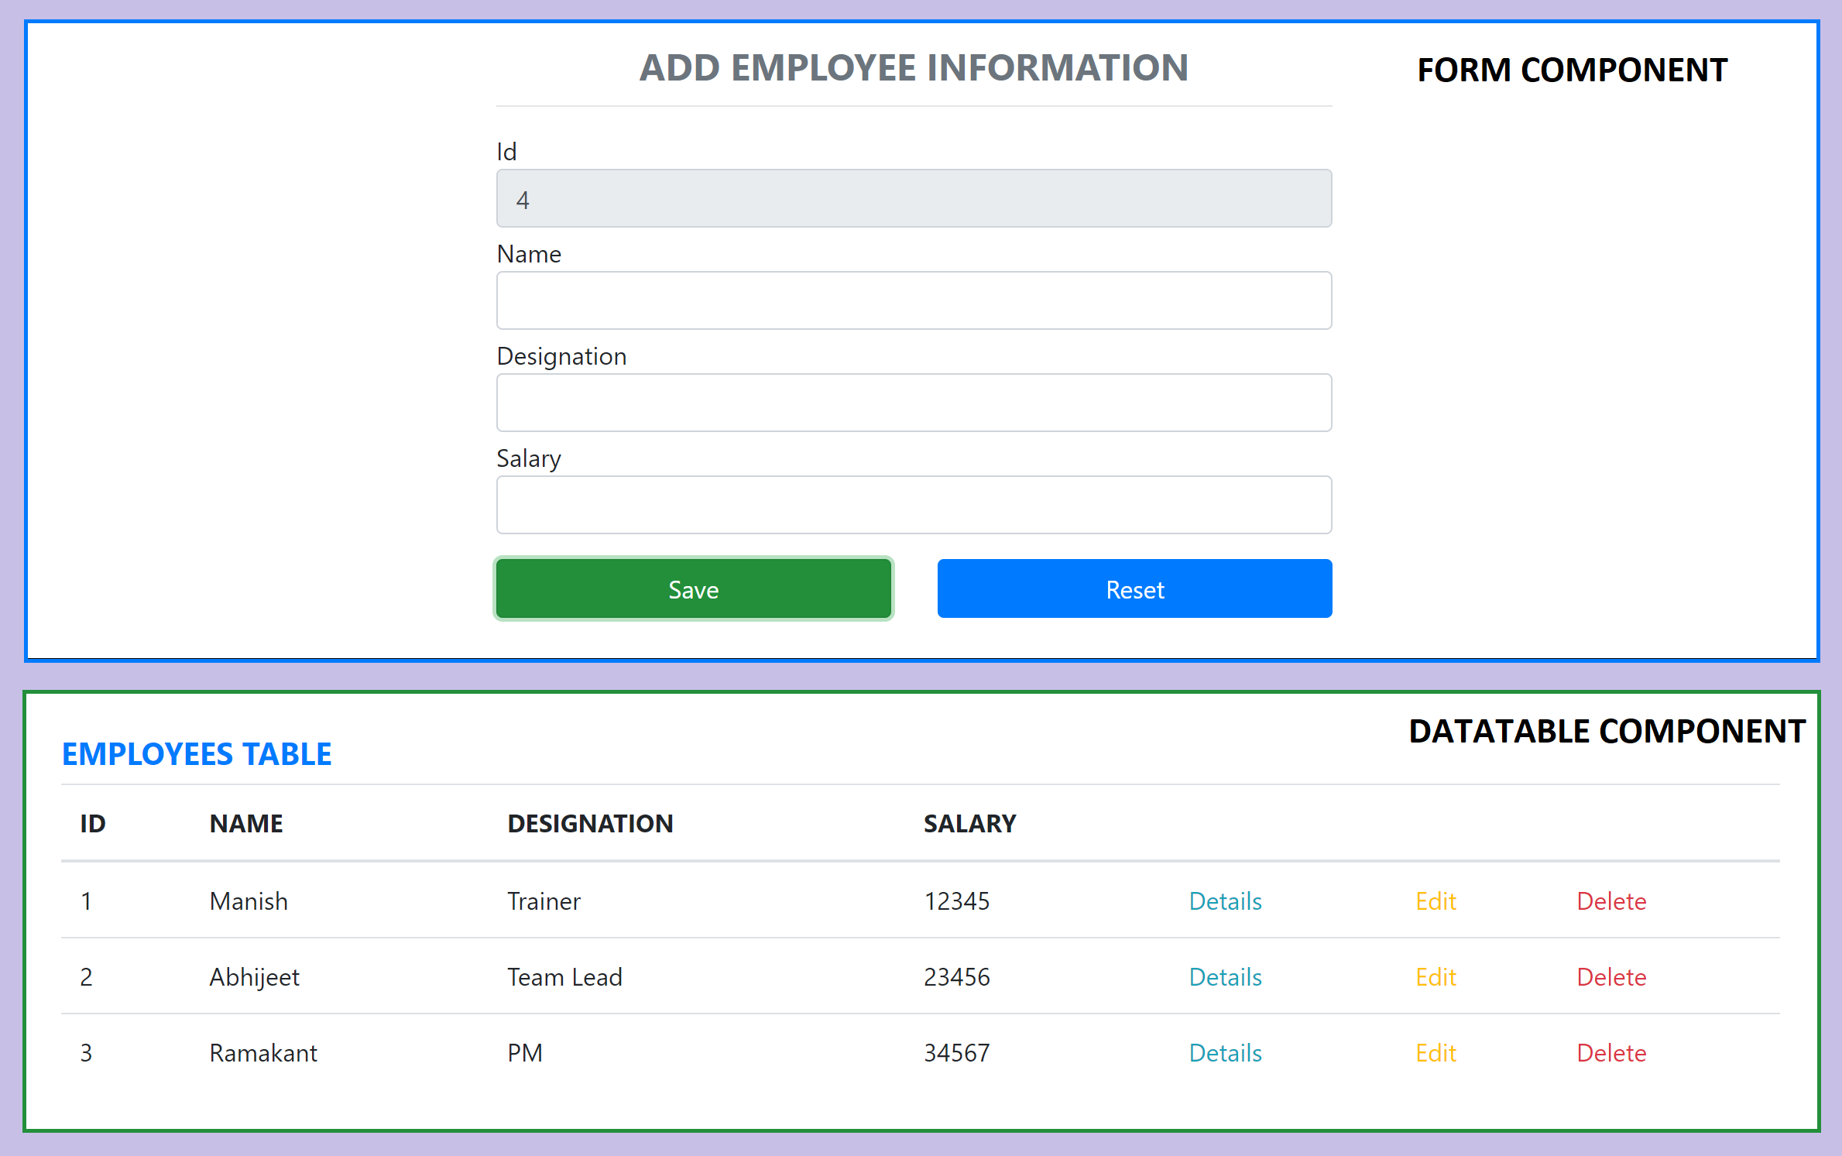
Assignment

Slide 44
AJAX and APIs
You can use any AJAX library you like with React.
Some popular libraries are:
Axios
jQuery AJAX
window.fetch
XMLHttpRequest
You should populate data with AJAX calls in the commit phase lifecycle methods like componentDidMount().
Use setState to update your component when the data is retrieved.

Slide 45
Hooks
Hooks are a new addition in React 16.8.
Hooks let you use state and other React features without writing a class.
Hooks are backwards-compatible
Built in Hooks
Basic Hooks
useState
useEffect
useContext
Additional Hooks
useReducer
useCallback
useMemo
useRef
useImperativeHandle
useLayoutEffect
useDebugValue

Slide 46
Assignment
Combine the useContext with useReducer to share the data across the component tree.

Slide 47
React Router
React Router is the de-facto React routing library, and it’s one of the most popular projects built on top of React.
React at its core is a very simple library, and it does not dictate anything about routing.
Routing in a Single Page Application is the way to introduce some features to navigating the app through links, which are expected in normal web applications:
The browser should change the URL when you navigate to a different screen
Deep linking should work: if you point the browser to a URL, the application should reconstruct the same view that was presented when the URL was generated.
The browser back (and forward) button should work like expected.
Routing links together your application navigation with the navigation features offered by the browser: the address bar and the navigation buttons.
React Router offers a way to write your code so that it will show certain components of your app only if the route matches what you define.

Slide 48
Router Components
Install
npm i react-router-dom@5
The 3 components you will interact the most when working with React Router are:
BrowserRouter wraps all your Route components.
Link/NavLink components are used to generate links to your routes
Route components are responsible for showing - or hiding - the components they contain.

Slide 49
NODE SERVER
BROWSER
HTTP + URL (localhost:3000)
NAVIGATION
React Application
Click on Admin Link, call to the API is done on componentDidMount and display the data in Datatable
HTML Page + JS (React App)
NODE SERVER
EXPRESS JS
Web API
AJAX – localhost:8000/api/products
Database
JSON

Slide 50
NODE SERVER
BROWSER
HTTP + URL (localhost:3000)
NAVIGATION
React Application
Click on Admin Link, code to verify token in browser’s sessionStorage, if not, we will be redirected to LoginComponent
HTML Page + JS (React App)
HTTP + URL (AJAX) + Username & Password
NODE SERVER
EXPRESS JS
Web API
JSON with Token
{“token”:”___”}
Store Token in Session
Storage of the browser
Send the same token to
Access data from the
server
AJAX – localhost:8000/api/products + Token
Database
JSON

Slide 51
Secure Application using Custom Route
When user clicks the Admin Link, we need to verify that we have a token in session storage, and if the token in not there in the session storage, redirect the request to login component. (SecuredRoute)
SecuredRoute uses AuthenticatorClient’s isAuthenticated to verify.
If false, the request is redirected to Login Component
If true, the request is allowed for Admin Component.
Logging and Token Management (AuthenticatorClient)
On Login Component, user must give username and password, which will be sent to Node API Server
If the username & password is correct, in the response; token will come from the Server
Received token will be stored in the session storage of the browser and isAuthenticated will be set to true.
Reading and Attaching Token
Whenever the AJAX request is made for api, we must read and attach the token in the request header.
We use AuthenticatorClient getToken() to read the token from session storage.

Slide 52
Secure Application using Custom Route
When user clicks the Admin Link, we need to verify that we have a token in session storage, and if the token in not there in the session storage, redirect the request to login component. (SecuredRoute)
SecuredRoute uses AuthenticatorClient’s isAuthenticated to verify.
If false, the request is redirected to Login Component
If true, the request is allowed for Admin Component.
Logging and Token Management (AuthenticatorClient)
On Login Component, user must give username and password, which will be sent to Node API Server
If the username & password is correct, in the response; token will come from the Server
Received token will be stored in the session storage of the browser and isAuthenticated will be set to true.
Reading and Attaching Token (fetch-interceptor)
Whenever the AJAX request is made for api, we must read and attach the token in the request header.
We use AuthenticatorClient getToken() to read the token from session storage.

Slide 53
React Component Libraries
https://react-bootstrap.github.io/
https://www.telerik.com/kendo-react-ui/
https://mui.com/
https://www.primefaces.org/primereact/showcase/#/datatable/striped
https://www.ag-grid.com/react-data-grid/?gclid=CjwKCAjwkvWKBhB4EiwA-GHjFjNh-cU_V1gzxcx1nte3R8wTjRGM_WdbOfVoOu0Kf4PWyQumjeHFCBoCLNoQAvD_BwE

Slide 54
Learn and Assignment
Learn Fetch API (CRUD)
Learn about Fetch Interceptor
Complete the CRUD Assignment with Users URL
How to use react-bootstrap package in React Application?
How to do UI validation in React? – Formik With React Bootstrap
Based on Login Status, display either Login Link or Logout Link

Slide 55
HOC (Higher Order Components)
HOC is a pattern that emerges from React’s compositional nature.
A higher-order component (HOC) is an advanced technique in React for reusing component logic.
Component transforms props into UI, a higher-order component transforms a component into another component.
A higher-order component is a function that takes a component and returns a new component.

Slide 56
Why HOC?
Reason to use Higher-Order component:
Easy to handle
Get rid of copying the same logic in every component
Makes code more readable

Slide 57
Portals
Portals provide a first-class way to render children into a DOM node that exists outside the DOM hierarchy of the parent component.
Portals render an element outside of its parent’s document.
Portals can be used to render an element outside of its parent component’s DOM node while preserving its position in the React hierarchy, allowing it to maintain the properties and behaviors it inherited from the React tree.

Slide 58
Redux
Redux is a pattern and library for managing and updating application state, using events called "actions".
It serves as a centralized store for state that needs to be used across your entire application, with rules ensuring that the state can only be updated in a predictable fashion.
The patterns and tools provided by Redux make it easier to understand when, where, why, and how the state in your application is being updated, and how your application logic will behave when those changes occur.

Slide 59
When Should I Use Redux?
Redux helps you deal with shared state management, but like any tool, it has tradeoffs. There are more concepts to learn, and more code to write. It also adds some indirection to your code and asks you to follow certain restrictions. It's a trade-off between short term and long-term productivity.
Redux is more useful when:
You have large amounts of application state that are needed in many places in the app
The app state is updated frequently over time
The logic to update that state may be complex
The app has a medium or large-sized codebase, and might be worked on by many people
Not all apps need Redux. Take some time to think about the kind of app you're building and decide what tools would be best to help solve the problems you're working on.

Slide 60
Redux Terminology
Actions - An action is a plain JavaScript object that has a type field. You can think of an action as an event that describes something that happened in the application.
Action Creators - An action creator is a function that creates and returns an action object. We typically use these, so we don't have to write the action object by hand every time
Reducers - A reducer is a function that receives the current state and an action object, decides how to update the state if necessary, and returns the new state. You can think of a reducer as an event listener which handles events based on the received action (event) type.
Store - The current Redux application state lives in an object called the store . The store is created by passing in a reducer.
Dispatch - The Redux store has a method called dispatch. The only way to update the state is to call store.dispatch() and pass in an action object. The store will run its reducer function and save the new state value inside. You can think of dispatching actions as "triggering an event" in the application.
Selectors - Selectors are functions that know how to extract specific pieces of information from a store state value.

Slide 61
Redux Application Data Flow

Slide 62
1
Will use the action types to identify an action which is dispatched, to do a specific operation on Store State
ACTION TYPE
Constants (string / symbol)
Will use action types to create an action object
3
R1
R2
R3
2
ACTION CREATOR
A function which creates and returns an Action object
ROOT REDUCER
REDUX STORE
Application State
4
ACTION OBJECT
Plain JavaScript Object
{
type: ActionType,
payload: data
}
CONTAINER COMPONENT
5
Dispatch
Action
Data Flow
PRESENTATIONAL COMPONENT (s)
6
mapDispatchToProps
mapStateToProps
Connection to Action Creator(s)
Connection to Reducer(s)

Slide 63
Redux Middleware and Side Effects
Redux store doesn't know anything about async logic. It only knows how to synchronously dispatch actions, update the state by calling the root reducer function, and notify the UI that something has changed.
Any asynchronicity has to happen outside the store.
Redux reducers must never contain "side effects". A "side effect" is any change to state or behavior that can be seen outside of returning a value from a function.
Some common kinds of side effects are things like:
Logging a value to the console
Saving a file
Setting an async timer
Making an AJAX HTTP request
Modifying some state that exists outside of a function, or mutating arguments to a function
Generating random numbers or unique random IDs (such as Math.random() or Date.now())
Redux middleware were designed to enable writing logic that has side effects.

Slide 64
Thunk Middleware – Async Data Flow
Thunk is a logical concept in programming where you deal with a function that is primarily used to delay the calculation or evaluation of any operation.
Redux Thunk acts as a middleware that will return you a function instead of an object while calling through the action creators.
The returned function receives the dispatch method from the store and then later it is used to dispatch synchronously inside the body of function once the asynchronous actions have been completed.

Slide 65
Redux Application Async Data Flow

Slide 66
1
Will use the action types to identify an action which is dispatched, to do a specific operation on Store State
ACTION TYPE
Constants (string / symbol)
Will use action types to create an action object
Dispatch
Action
3
R1
R2
R3
2
ACTION CREATOR
A function which creates and returns an Action object
REDUX
THUNK
MIDDLEWARE
API SERVER
ROOT REDUCER
A function that takes parameter dispatch
REDUX STORE
Application State
4
ACTION OBJECT
Plain JavaScript Object
{
type: ActionType,
payload: data
}
CONTAINER COMPONENT
5
Dispatch
To Function
Data Flow
PRESENTATIONAL COMPONENT (s)
6
mapDispatchToProps
mapStateToProps
Connection to Action Creator(s)
Connection to Reducer(s)

Slide 67
Points to Remember
ActionTypes are used for Creating Action Objects and also helps reducer to recognize Action which is dispatched to it.
REACT COMPONENT -> DISPATCHER -> ACTION -> REDUCER -> STORE -> REACT COMPONENT
How Component will know about the Dispatch/Dispatcher?
Component uses connect() to get access to the Dispatch which is used in mapDispatchToProps()
In functional components we use useDispatch() Hook
How Component will know about the State?
Component uses connect() to get access to state which is used in mapStateToProps(),
In functional components we use useSelector() Hook
How Component will know about the Actions?
Component takes the actions (action Objects) to be performed from ActionCreators (counterActions, productActions)

Slide 68
React best practices
Keep components small and function-specific
Reusability is important, so keep creation of new components to the minimum required
Consolidate duplicate code – DRY your code
Put CSS in JavaScript
Name the component after the function
Separate stateful aspects from rendering
Prefer Immutation over Mutation of Data
Prefer to write Pure Function

Slide 69
Assignment / Practice
Complete the Requested and Failed logic for
Insert
Update
Delete
In the Redux application, consume the node-api-server (Day3) and create a CRUD application using fetch-interceptor
Complete the CRUD application using only Functional Components with Hooks.
Change Router from v5 to v6, in Redux application

Slide 70
Further Learning
Do it only after you have completed the code and assignments and comfortable with what we covered in the training

Slide 71
Redux Saga Middleware
Saga pattern is way a to handle long running transactions with side effects or potential failures.
Redux-saga is a redux middleware library, that is designed to make handling side effects in your redux app nice and simple.
It achieves this by leveraging an ES6 feature called Generators, allowing us to write asynchronous code that looks synchronous.

Slide 72
Thunk vs Saga
Thunk | Saga
Created by Redux Creator | Created by third party developers
Runs in any JavaScript Context | Only runs in ES6 environments that support yield
Has no built-in solution for asynchronous calls | Uses yield and generator functions to simplify async
No way to orchestrate side-effects between thunks | Uses effects and plain actions to coordinate sagas

Slide 73
React Final Form
High performance subscription-based form state management for React.
React Final Form is a thin React wrapper for Final Form, which is a subscriptions-based form state management library that uses the Observer pattern, so only the components that need updating are re-rendered as the form's state changes.
React Final Form strives to meet the following goals:
Modularity
Minimal Bundle Size
High Performance

Slide 74
Contact Me
Manish Sharma | Gmail
Manish Sharma | WhatsApp
Manish Sharma | Facebook
Manish Sharma | LinkedIn

